Slide 1





SECURING ONLINE PAYMENTS: AI-BASED fraud detection for e-COMMERCE PLATFORMS
E-commerce and Online Retail refers to the buying and selling of goods and services over the internet, where businesses and consumers engage in digital transactions through various online platforms.
Anurag Jaipal Rathore | X23271302
MSc Data Analytics
National College of Ireland | 2025

Slide 2


PROJECT OVERVIEW
Background & Scope
Project Goals
Business Value
Rise in e-commerce has led to a surge in online payment fraud
Traditional rule-based systems struggle with modern fraud tactics
Scope: Build an AI model that detects fraud in real-time using transaction data
Use of a large-scale, realistic dataset (PaySim) for model training and evaluation
Identify patterns in fraudulent and non-fraudulent transactions
Create engineered features that reflect transactional behavior
Build accurate and scalable ML models to classify fraud
Implement a prototype capable of real-time fraud prediction
Reduces financial loss by accurately identifying fraud
Enhances customer trust through proactive fraud prevention
Minimizes false positives to avoid disrupting legitimate transactions
Scalable framework that can be integrated into real e-commerce platforms

Slide 3
PROBLEM STATEMENT
Online payment fraud causes billions in losses annually across e-commerce platforms.
Rule-based fraud detection systems are static and easily bypassed by sophisticated attackers.
High false positive rates disrupt legitimate customer transactions, harming user experience.
There is a critical need for intelligent, adaptive AI models that can detect evolving fraud tactics in real time.

Slide 4


RESEARCH OBJECTIVES
EXPLORE FRAUD PATTERNS VIA EDA
ENGINEER MEANINGFUL FINANCIAL FEATURES
ADDRESS CLASS IMBALANCE USING SMOTE
TRAIN AND EVALUATE ML MODELS
DEPLOY BEST MODEL IN A WORKING PROTOTYPE

Slide 5
LITERATURE REVIEW SUMMARY
AI and ML are increasingly used to enhance fraud detection in digital finance
Ensemble models like Random Forest and XGBoost outperform traditional methods due to their accuracy and robustness
SMOTE effectively addresses extreme class imbalance in fraud datasets
Explainable AI is essential for transparency, trust, and regulatory compliance

Slide 6

DATASET AND TOOLS
The dataset comes from PaySim, a realistic simulation that mirrors the complexities of mobile financial transactions. It offers a rich variety of features suited for training fraud detection models. The tools used span the entire ML pipeline from cleaning and modeling in Python, to serving predictions through a Flask web application. This ensures both analytical depth and real-world applicability.
DATASET: PAYSIM (11 FEATURES, 6.3M ROWS)
TARGET: ISFRAUD (BINARY CLASSIFICATION)
TOOLS: PYTHON, SCIKIT-LEARN, XGBOOST, FLASK
JOBLIB: SAVING AND LOADING TRAINED MODELS AND TRANSFORMERS

Slide 7

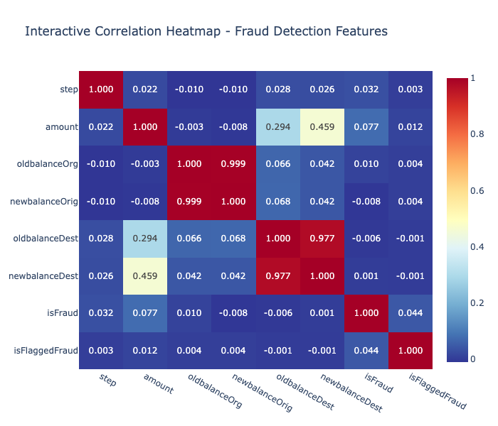
DATA PREPARATION & FEATURE ENGINEERING
Removed irrelevant columns (nameOrig, nameDest)
Converted transaction type into multiple binary columns (one-hot encoding)
Created new features like:
Change in sender and receiver balances
Ratios of transaction amount to account balances
Scaled all numeric values to have the same range (StandardScaler)
Used PCA to reduce the number of features while keeping 95% of important data

Slide 8

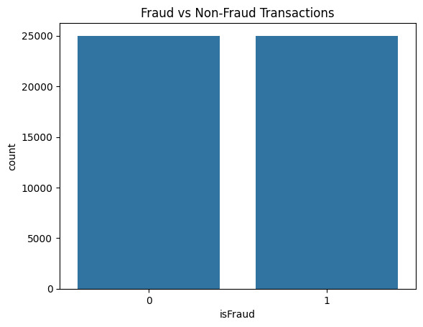
HANDLING CLASS IMBALANCE
Fraud transactions made up only 0.13% of the entire dataset
Class imbalance can cause models to ignore the rare fraud cases
Used SMOTE (Synthetic Minority Over-sampling Technique) to generate 25,000 fraud examples
Randomly selected 25,000 non-fraud cases from the majority class
Combined both sets to create a balanced dataset of 50,000 records

Slide 9
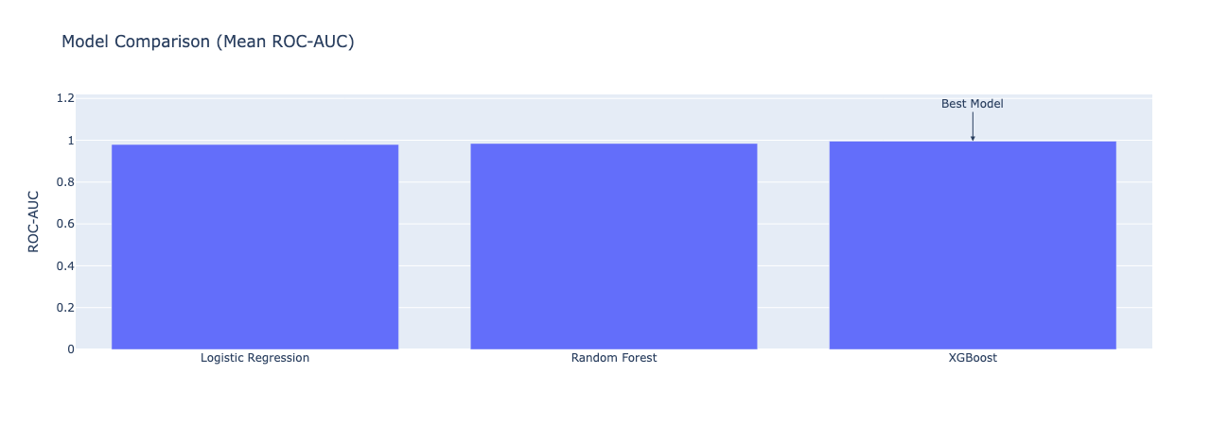
MODEL EVALUATION
LOGISTIC REGRESSION: ROC-AUC 0.9803
RANDOM FOREST: ROC-AUC 0.9881
XGBOOST: ROC-AUC 0.9958, ACCURACY 96.6%

Slide 10
SYSTEM ARCHITECTURE & PROTOTYPE
Three-tier architecture for clean separation of components:
Frontend (Flask) – Web form to input transaction details
Backend (Inference Engine) – Runs trained ML model for predictions
Storage Layer – Holds saved model, scaler, and PCA files (.pkl) using Joblib
Input data is processed using the same pipeline as training:
Scaler standardizes the input
PCA reduces dimensionality
XGBoost model makes the final prediction
Real-time fraud prediction through a user-friendly web interface
Prediction result (Fraudulent / Not Fraudulent) and confidence score is shown instantly

Slide 11




KEY FINDINGS & CONTRIBUTIONS
PERFORMANCE
FEATURE ENGINEERING
XGBoost achieved highest accuracy and lowest error
Feature engineering and SMOTE were key to success
SYSTEM DEVELOPMENT
BUSINESS VALUE
Web-based prototype delivers real-time fraud predictions
Validates practical value of AI in e-commerce fraud prevention

Slide 12
CONCLUSION & FUTURE WORK
The project confirms the value of AI in detecting fraud efficiently and accurately. However, real-world deployment requires handling real-time data, maintaining interpretability, and adapting to new fraud patterns. Future enhancements will focus on transparency, resilience, and scalability—making the system enterprise-ready.
EFFECTIVENESS
CHALLENGES
OPPORTUNITIES
Achieved high accuracy, precision, and recall using machine learning
Synthetic dataset (PaySim): Doesn’t capture all real-world complexities
Explainability: Use tools like SHAP or LIME to interpret model decisions
Real-time prediction capability adds strong operational value
PCA transformation: Reduces interpretability of model decisions
Advanced models: Explore Graph Neural Networks (GNNs) for fraud ring detection

Slide 13
THANK YOU

